Slide 1

Investigating autoencoders as a linkage between differing reservoir structures
Milestone Meeting 3

Slide 2

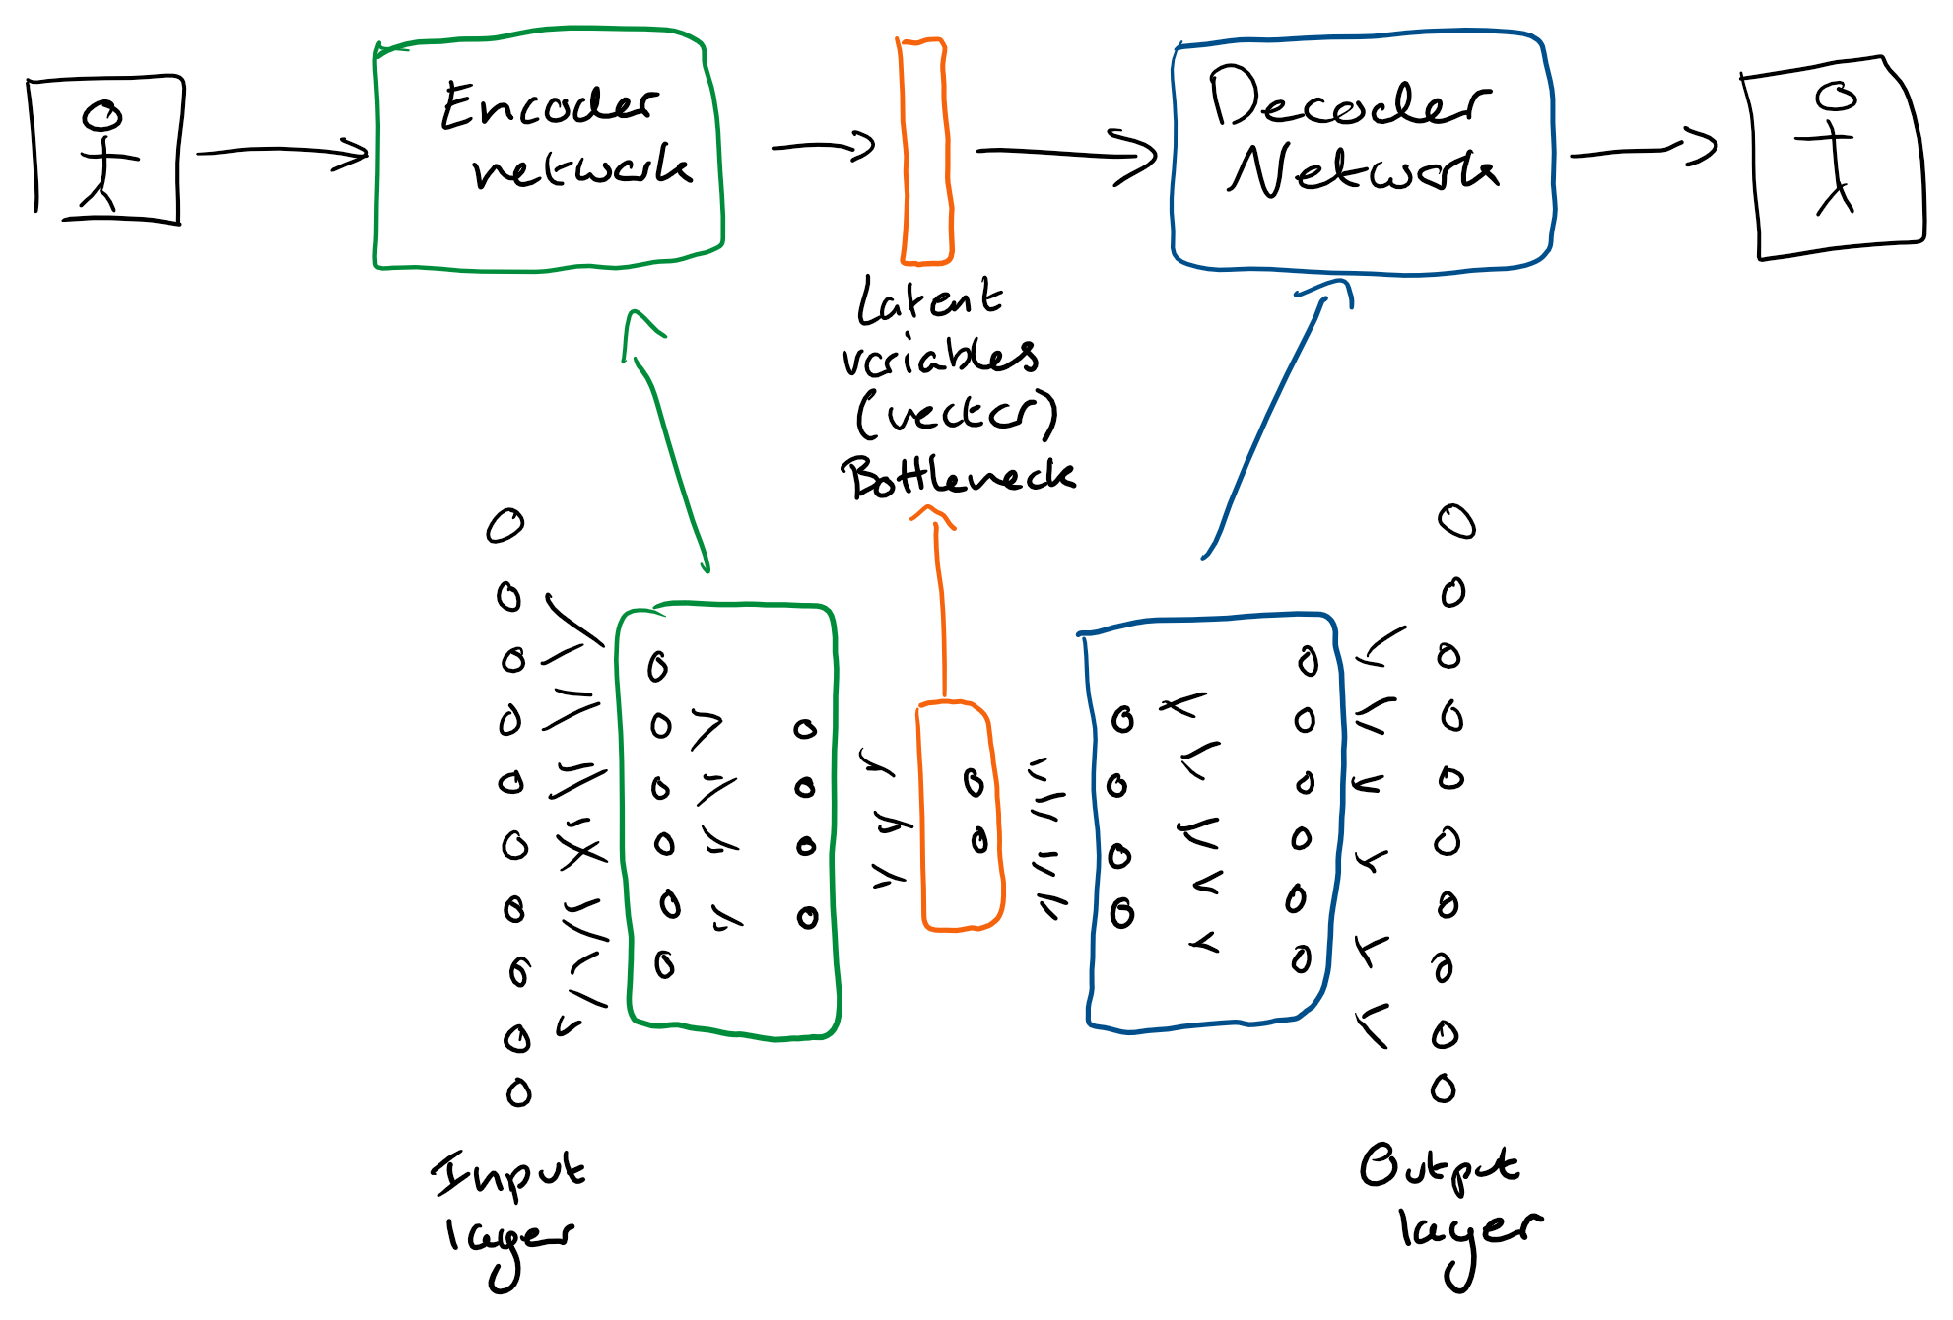
What is an autoencoder?
An autoencoder is a feedforward neural network that reduces the dimensionality of its input layer by encoding to a latent vector (bottleneck). Which is then decoded back to the original input.
This allows the autoencoder to learn the inherent properties of its input.

Slide 3

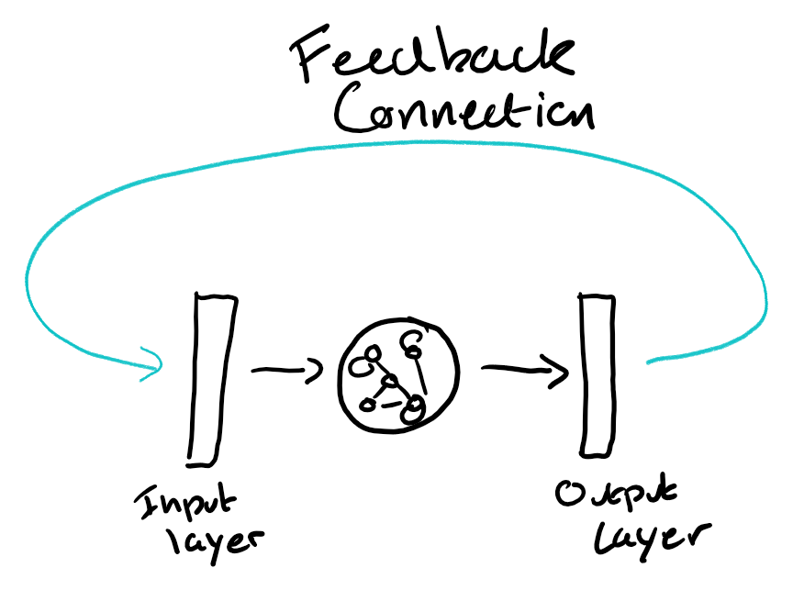
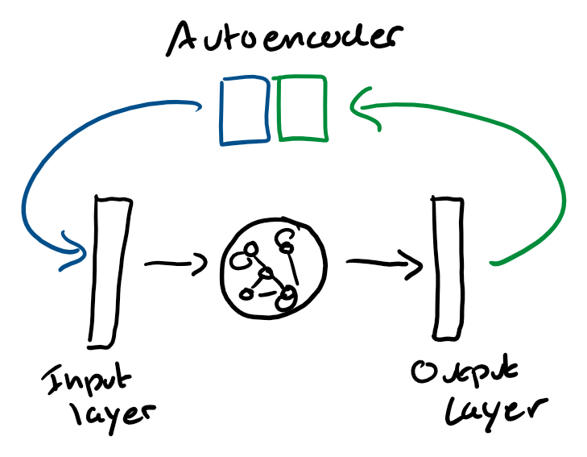
Feedback connection
The point of a feedback connection is to preserve the networks state between runs of the network.
In the case of an ESN, we can use them to preserve state beyond the fading memory of the reservoir.
The feedback connection is trained by the output layer to be correct for that network.
Feedback connection with autoencoding
The autoencoder in the feedback connection of the ESN learns additional auxiliary information that is not human readable that the network is using to make its decisions.

Slide 4
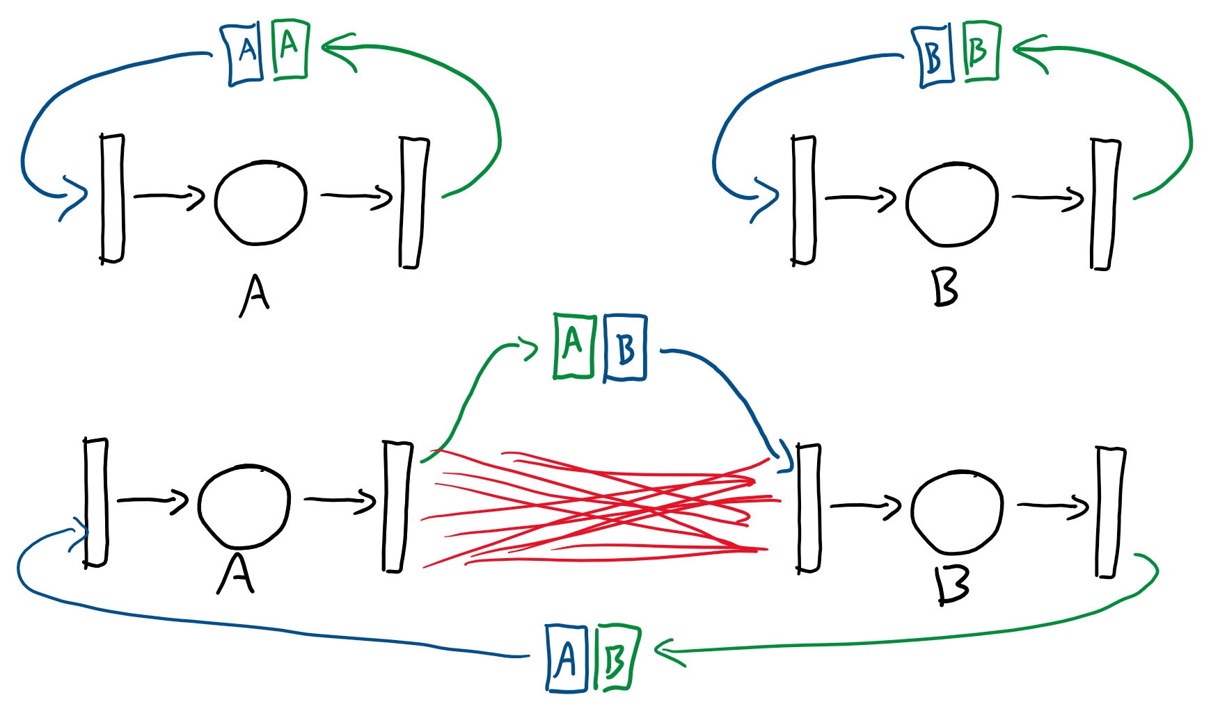
Together?
Feedback connection though the hole network gives both networks full view of all the information each separate network is using internally to solve its problem allowing the hole network to view the hole problem.
This allows us to connect two ESNs with more than just a linear output to input layer.
If this connection works well then it could be applied to more than two ESNs at a time.

